Slide 1

MINOR PROJECT- THIRD REVIEW ANALYSIS OF MARINE PLASTIC LITTER CONTRIBUTION BY VARIOUS COUNTRIES AND WASTE CLASSIFICATION
PROJECT GUIDE-DR.A.SHIRLY EDWARD
S SEETHALAKSHMI [RA1811004040001]
M RADHIKA [RA1811004040019]
ECE-A, IV YEAR

Slide 2
TABLE OF CONTENT
HEADING | SLIDE NO.
OBJECTIVE | 3
ABSTRACT | 4
LITERATURE SURVEY | 5
FLOWCHART | 6
PROCESS | 7
RESULT | 25
CONCLUSION | 26
REFERENCES | 27

Slide 3
OBJECTIVE
Marine debris – man-made objects that enter the marine environment through careless handling or disposal, intentional or unintentional release, or as a result of natural disasters and storms – is one of the ocean’s most pervasive, yet potentially solvable, pollution problems. It can harm ocean ecosystems, wildlife, and humans. It can injure coral reefs and bottom-dwelling species and entangle or drown ocean wildlife. Some marine animals ingest smaller plastic particles and choke or starve. Human health is also at risk, as plastics may break down into smaller pieces that may subsequently end up in our food. The economic impact of marine litter is thought to be significant. Thus, it is necessary to understand the consequences of this issue and create awareness.

Slide 4
ABSTRACT
While there are different types of waste that are thrown along the shoreline due to the lack of awareness about proper disposal methods, the most concern causing among them all are the plastic wastes.
In our project we try to analyse the extent to which the countries around the world contribute to marine plastic litter and visualize the data.
Later in order to understand and classify the different types of wastes that are being disposed in an incorrect manner, we try to classify them using a user interface.

Slide 5
LITERATURE SURVEY
Different types of wastes require different management techniques and hence, proper waste segregation according to its types is essential to facilitate proper recycling. Current existing segregation methods still relies on manual hand-picking process.
One of the most frequently used deep learning methods for image classification is the Convolutional Neural Network (CNN); which performs well in classifying image datasets as well as for real-time image recognition applications.
AlexNet was proposed as part of ImageNet Large Scale Visual Recognition Challenge in 2012, by making the architecture deeper with a number of parameter optimizations strategies. However, the architecture suffers from overfitting due to its increase depth (Ref[3])
Multiple-layered Convolutional Neural Network model, specifically the well-known Inception-v3 model has been used for classification of waste, with trained dataset obtained from online sources. Apart from its complexity due to more number of hidden layers, this model overfits and provides less accuracy in some cases (Ref [3]).

Slide 6
FLOWCHART
Data visualization
Waste classification
Importing Libraries
Loading image dataset
Training the algorithm
Importing Libraries
Loading Data
Plotting Data Distribution
Analysis & Visualization
Testing the algorithm
User Interface
Uploading the image of the waste to be classified.
Show the proper disposal method of the waste upon classification.

Slide 7
PROCESS A. AWARENESS THROUGH DATA VISUALIZATION

Slide 8
We downloaded a dataset that gave information about the extent to which a few countries around the world contributed to marine plastic litter.
The dataset takes into account different rivers of these countries as they act as conduits of litter from inland to ocean.
Analysing the datasets that inform the degree of plastic litter in various rivers from different countries would help in visualising the contribution of every country taken into account, importantly in visualising which country contributes the most.
We analyzed the data by plotting the distribution.
This process of data visualization gives a sense of understanding and awareness about the criticality of the issue.

Slide 9

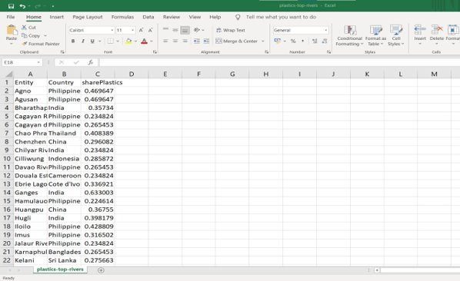



DATASET
LANGUAGE USED:
Python 3
PLATFORM USED:
Jupyter Notebook
LIBRARIES:
numpy
seaborn
pandas
matplotlib.pyplot
DATASET:
plastics-top-rivers.csv
Source: IUCN website

Slide 10
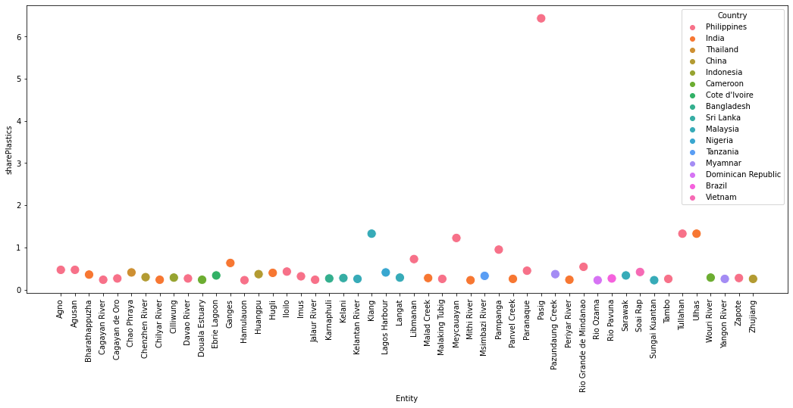
ENTITY VS SHARE PLASTICS- SCATTER PLOT

Slide 11
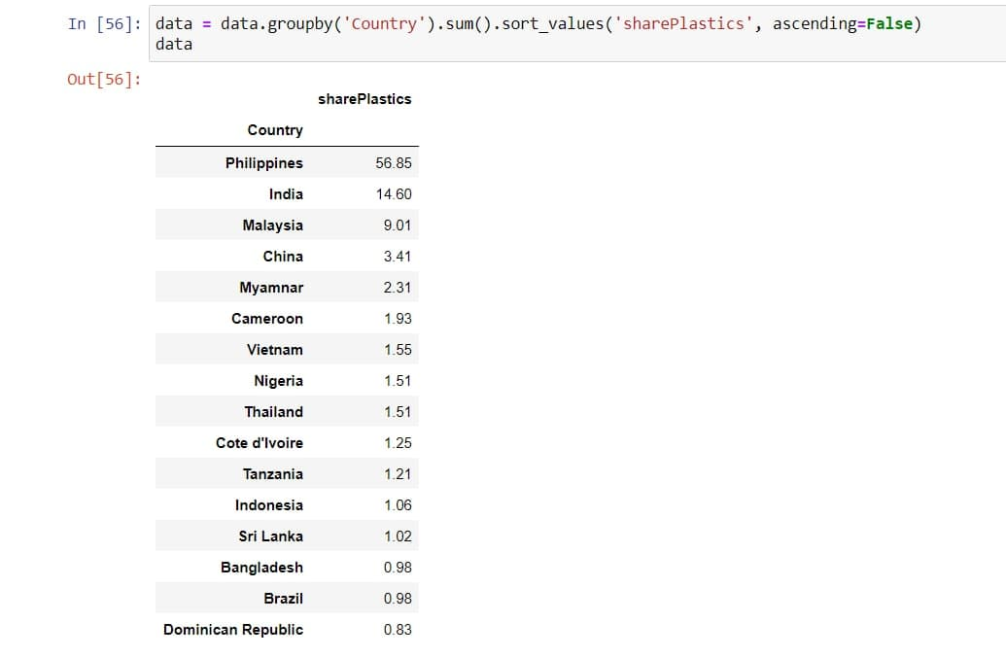
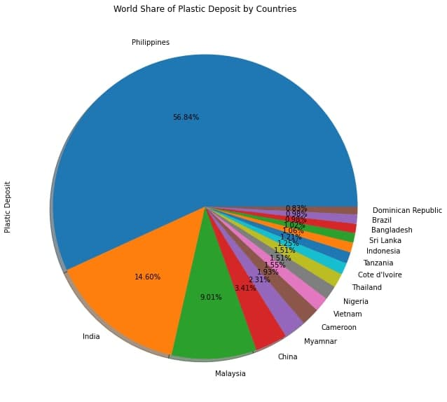
WORLD SHARE OF PLASTICS-PIE CHART
Philippines is high in plastic deposit, with a world share of 56.84%.
Its PASIG river contributes the most to this.

Slide 12
B. A POTENTIAL SOLUTION THROUGH WASTE CLASSIFICATION

Slide 13
Apart from just understanding the presence of plastic litter, it is necessary to classify the different categories of waste disposed along the shorelines.
We downloaded an image dataset consisting of approximately 8000 images.
All the images belong to the following 9 categories: light blubs, paper, plastic, organic, glass, batteries, clothes, metal and e-waste.
The dataset is trained using VGG16 Transfer Learning technique of CNN for classification.
We tried training the algorithm using different optimizers like Adam, Adamax and Nadam to check which provides the better result.
On feeding a test image, the algorithm correctly classifies the category of the waste

Slide 14
VGG-16
Oxford Visual Geometry Group (or) VGG-16 is a convolution neural network (CNN) architecture which was used to win ILSVR (ImageNet) competition in 2014.
The ImageNet Large Scale Visual Recognition Challenge (ILSVRC) evaluates algorithms for object detection and image classification at large scale.
ImageNet is a large dataset of 14,197,122 annotated images belonging to 1000 classes intended for computer vision research.
VGG-16 being a pre-trained model can be loaded via the Applications interface provided by Keras. By the method of Transfer learning, this model developed for a task is reused as the starting point for a model in our project.

Slide 15
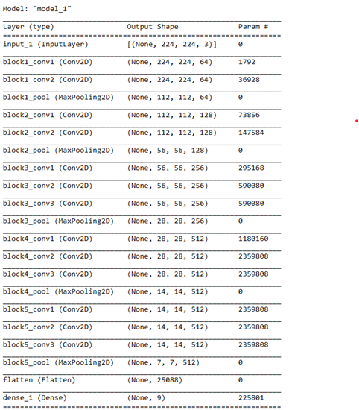
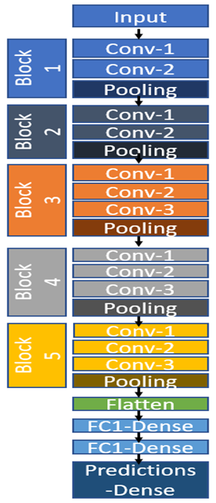
VGG-16 ARCHITECTURE
VGG-16 contains three different parts: convolution, pooling and fully connected layers — it starts with two convolution layers followed by pooling, then another two convolutions followed by pooling, after that repetition of three convolutions followed by pooling, and then finally three fully connected layers (Ref [8]).

Slide 16
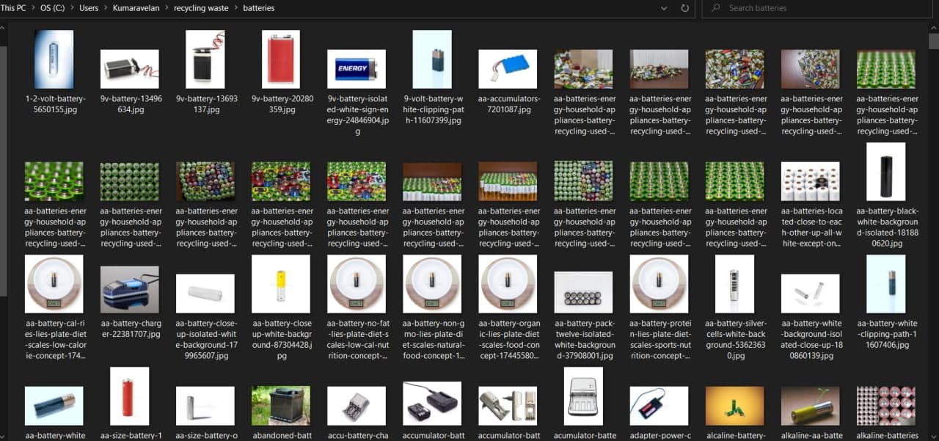
IMAGE DATASET
TECHNOLOGY USED: Deep Learning
PLATFORM USED:
Jupyter Notebook
LIBRARIES:
Tensorflow -> keras
DATASET:
"recycling waste" image folder
Source: GitHub

Slide 17
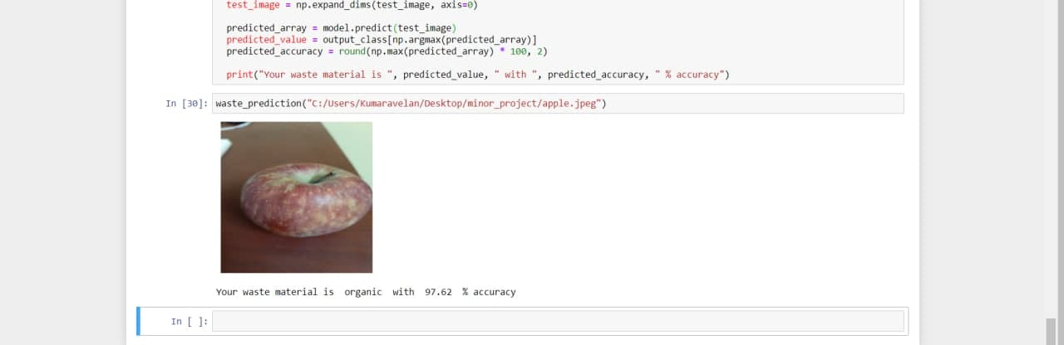
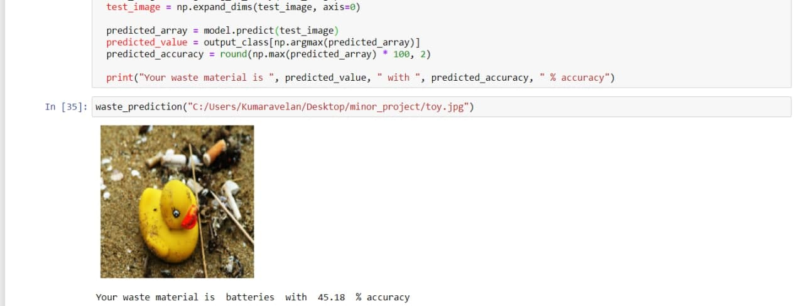
A. USING NADAM

Slide 18
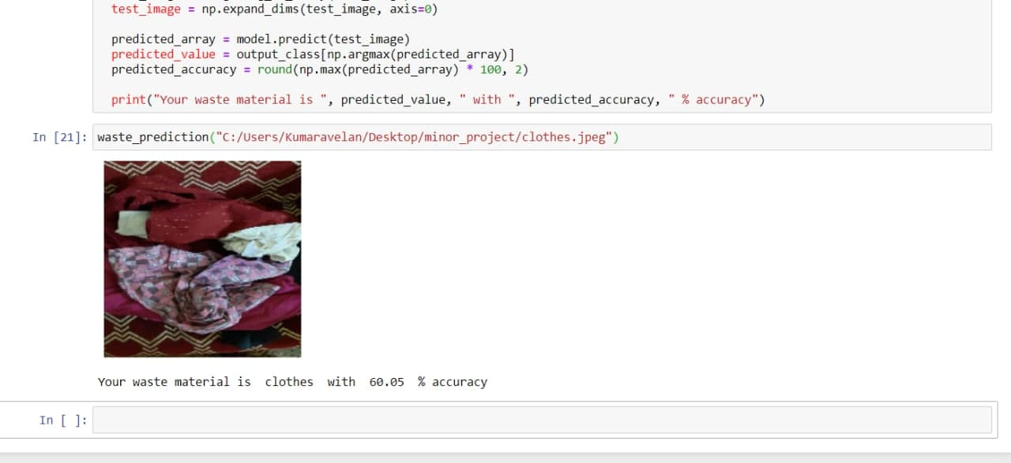
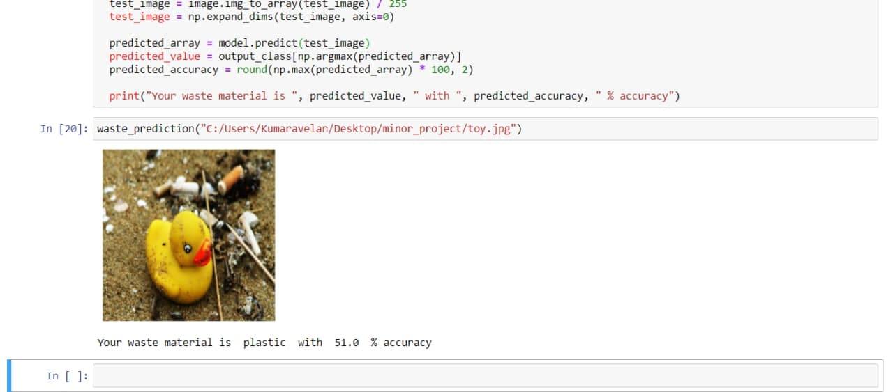
B. USING ADAMAX

Slide 19
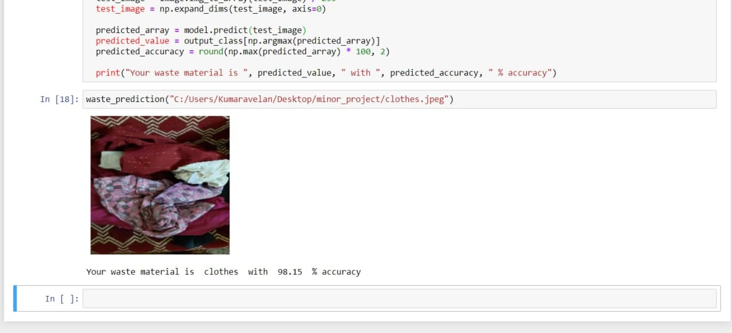
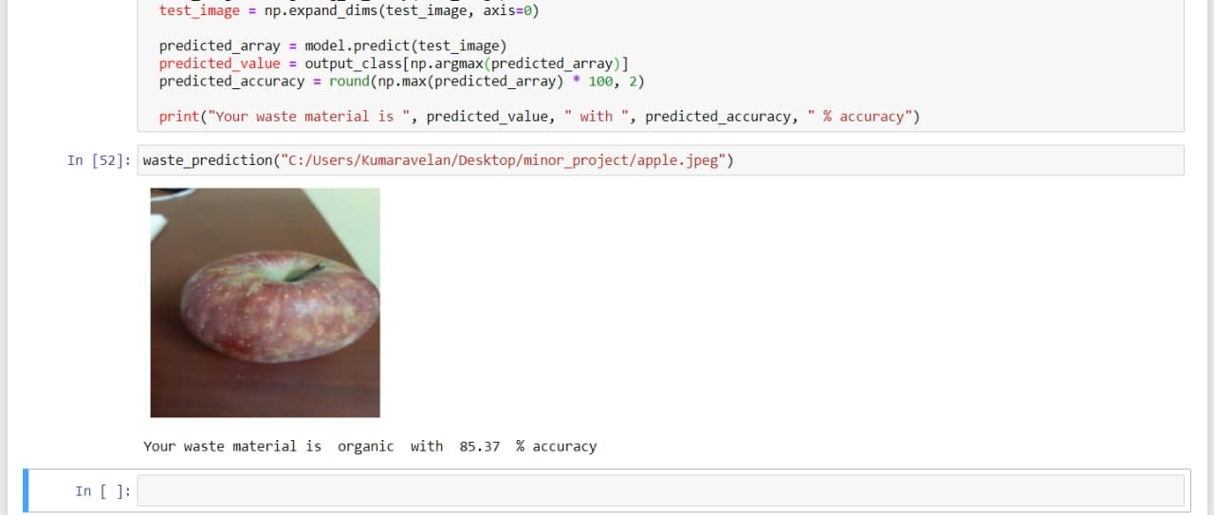
C. USING ADAM

Slide 20
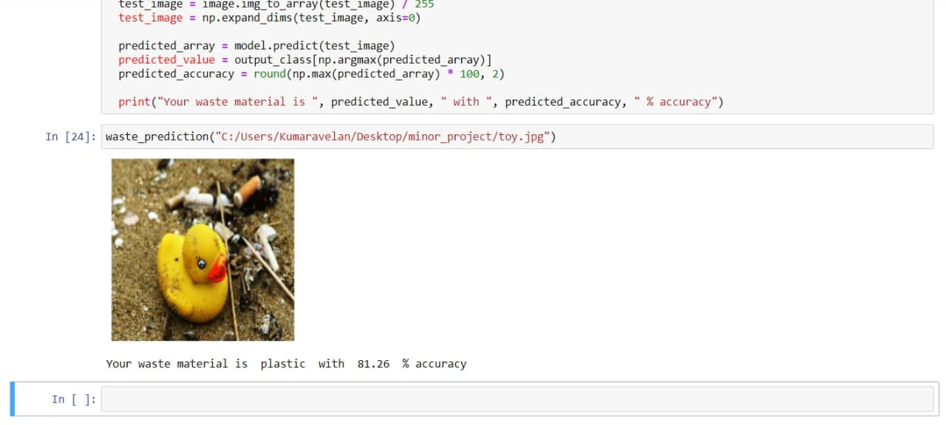
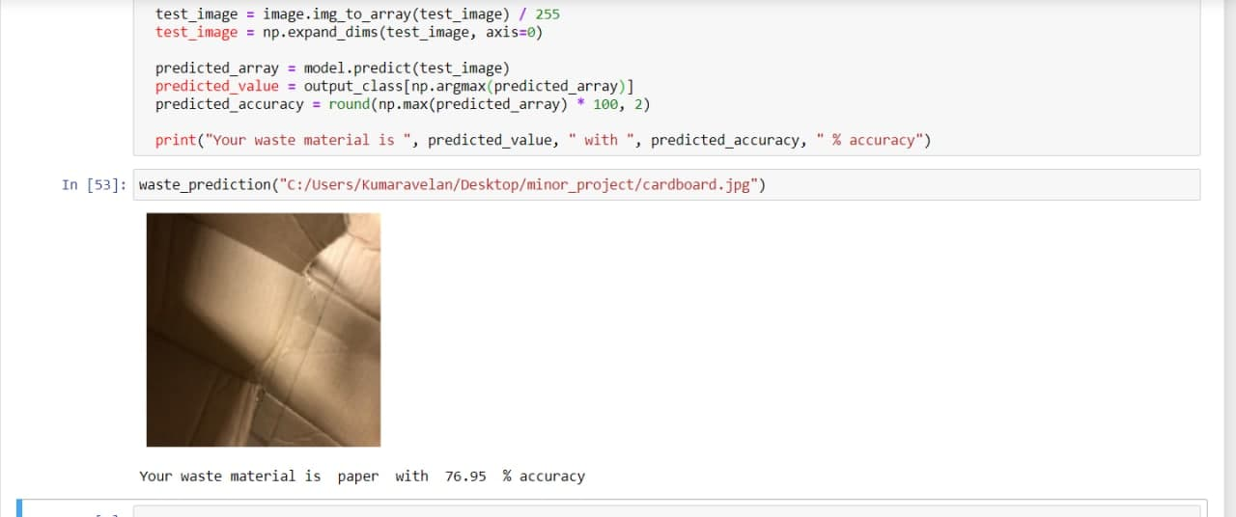

Slide 21
C. USER INTERFACE

Slide 22
We extended our project by developing a web application that would help in waste classification. This web application can classify waste into 9 different waste classes. For frontend, technologies like HTML(Hypertext Markup Language) and CSS(Cascading Style Sheets) are used. Flask, which is a web framework in python is used for backend.
The web application works as follows:
Click on the button "CLASSIFY IMAGE".
Upload an image of any waste.
The web application would then classify the waste to its respective category and display the name of the category.
It would also provide the users with an insight on the particular type of waste and its proper disposal/recycling method.
This web application would help in creating awareness.

Slide 23
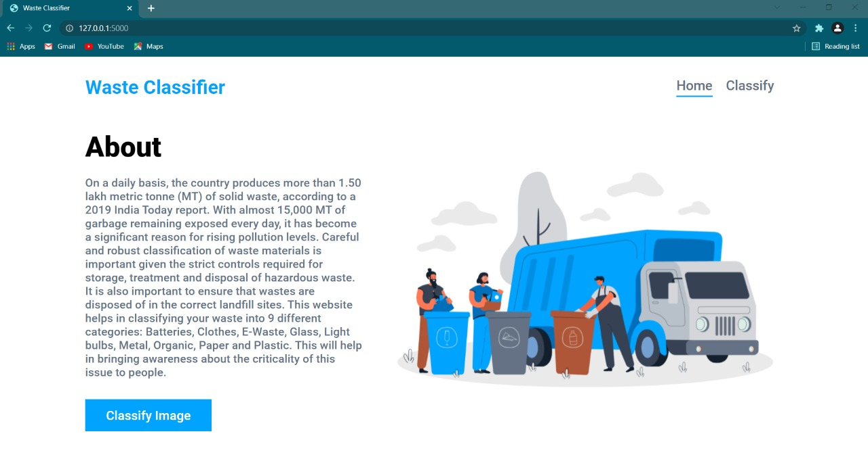
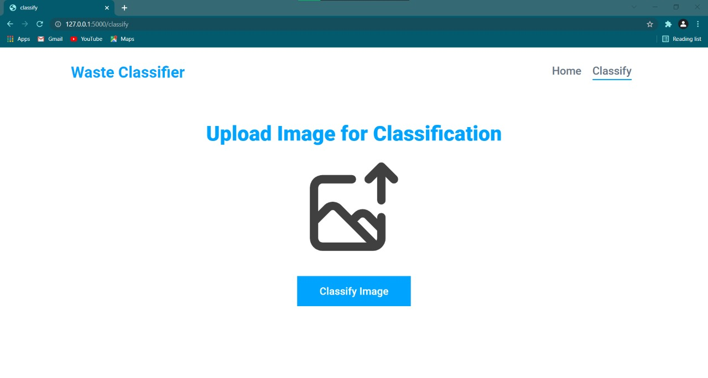
THE INTERFACE

Slide 24
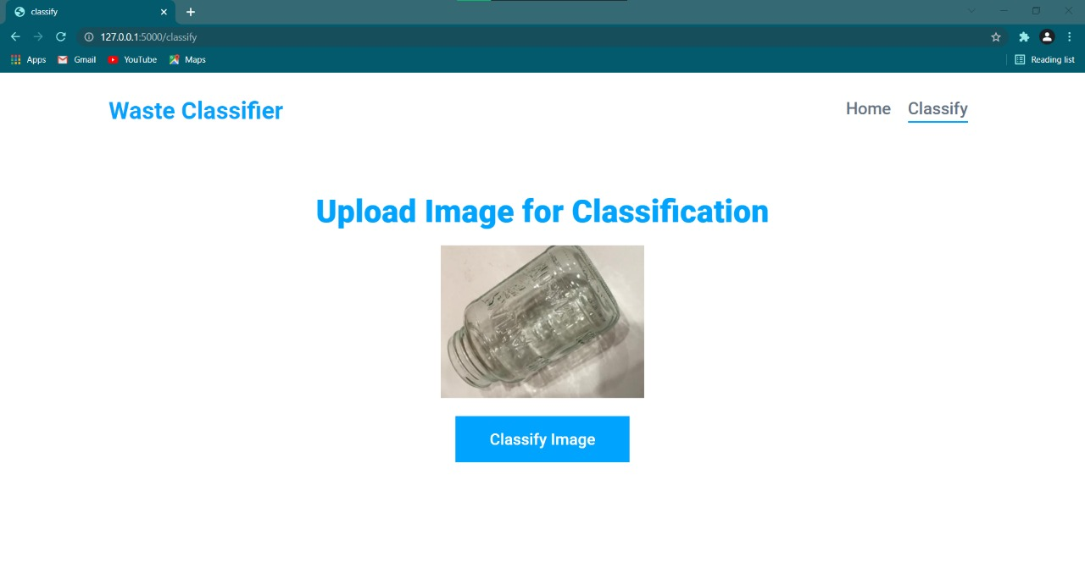
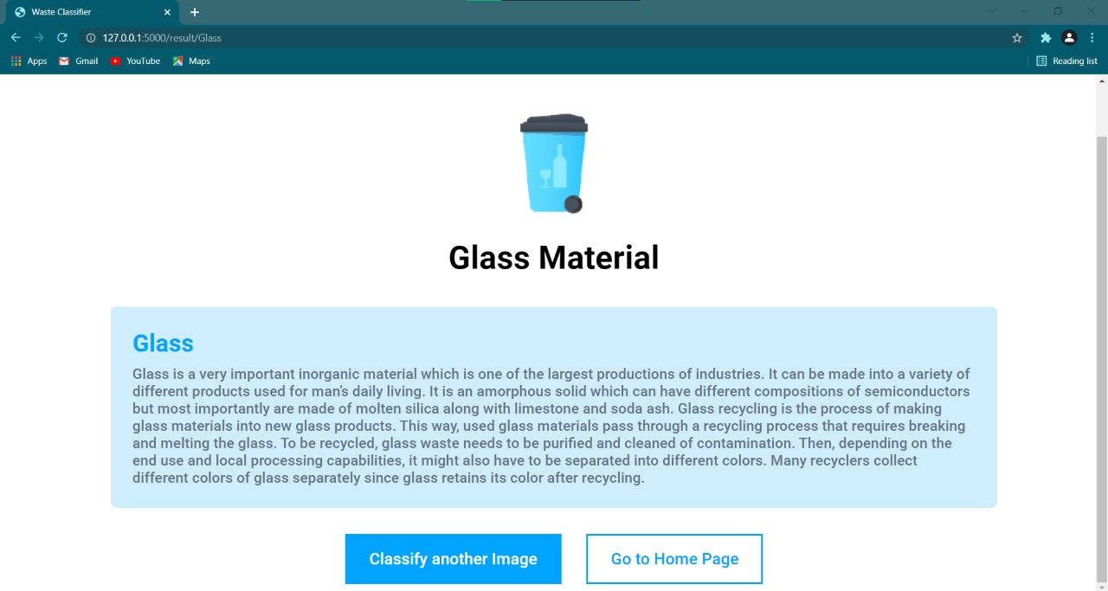

Slide 25
RESULT
Through the first step of this project, i.e., data visualization, on analysing rivers of different countries, we were able to identify that Philippines is high in plastic deposit, with a world share of 56.84%. Its PASIG river contributes the most to this(as per 2019 dataset of IUCN). In the second step i.e., waste segregation, we were able to segregate different types of wastes using VGG16 Transfer Learning technique of CNN. On using three different optimizers available in Keras library, the results were:
NADAM optimizer did not classify the images into the correct category.
ADAMAX optimizer classified the images into the correct category with an accuracy of 62 percentage.
ADAM optimizer classified the images into the correct category with an accuracy of 90 percentage.

Slide 26
CONCLUSION
Given the criticality of the issue of marine litter and its dire consequences, we were motivated to visualize the extent of marine litter contribution by a few countries and also develop a solution that would bring awareness.
We visualized a dataset from the year 2019 and studied the contribution of a few countries as the first step of our project.
We then developed a waste classification algorithm using VGG-16 as the second step of our project.
We later developed a web application that would act as an user interface that would help in waste classification on uploading the image of any waste.
We thus could get a holistic view of the issue.

Slide 27
REFERENCES
[1] “Garbage recognition and classification system based on convolutional neural network VGG16” by Wang Hao, Wuhan University of Technology at 2020 3rd International Conference on Advanced Electronic Materials, Computers and Software Engineering (AEMCSE).
[2] “Very Deep Convolutional Neural Network Based Image Classification Using Small Training Sample Size” by Shuying Liu, Weihong Deng, Beijing University of Posts and Telecommunications, Beijing, China at 2015 3rd IAPR Asian Conference on Pattern Recognition.
[3] “Waste Classification using Convolutional Neural Network” by Azis, F. A., Suhaimi, H., & Abas, E. at Proceedings of the 2020 2nd International Conference on Information Technology and Computer Communications.
[4] “Transfer Learning for Visual Categorization: A Survey” by Shao, Ling; Zhu, Fan; Li, Xuelong (2015).
[5] “An Iterative Transfer Learning based Classification framework” by Yang, Jihai; Li, Shijun; Xu, Wenning at Conference on Neural Networks (IJCNN) - Rio de Janeiro, Brazil (2018.7.8-2018.7.13)] 2018 International Joint Conference on Neural Networks (IJCNN).
[6] https://www.iucn.org/
[7] https://github.com/
[8]https://towardsdatascience.com/a-demonstration-of-transfer-learning-of-vgg-convolutional-neural-network-pre-trained-model-with-c9f5b8b1ab

Slide 28
THANK YOU

